Slide 1


Work from anywhere
Sync your files to the cloud with OneDrive
Save your files to OneDrive
Store files in your OneDrive and reach them from all your devices.
Share with everyone
Access, share, or work with others in real-time
while protecting your files from loss and attacks.

Slide 2

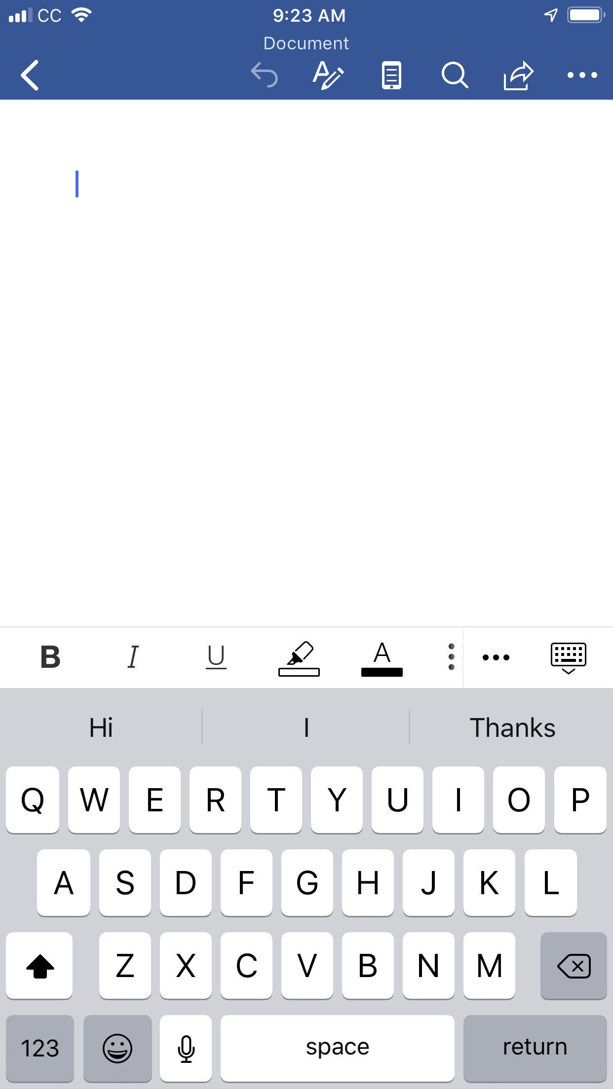
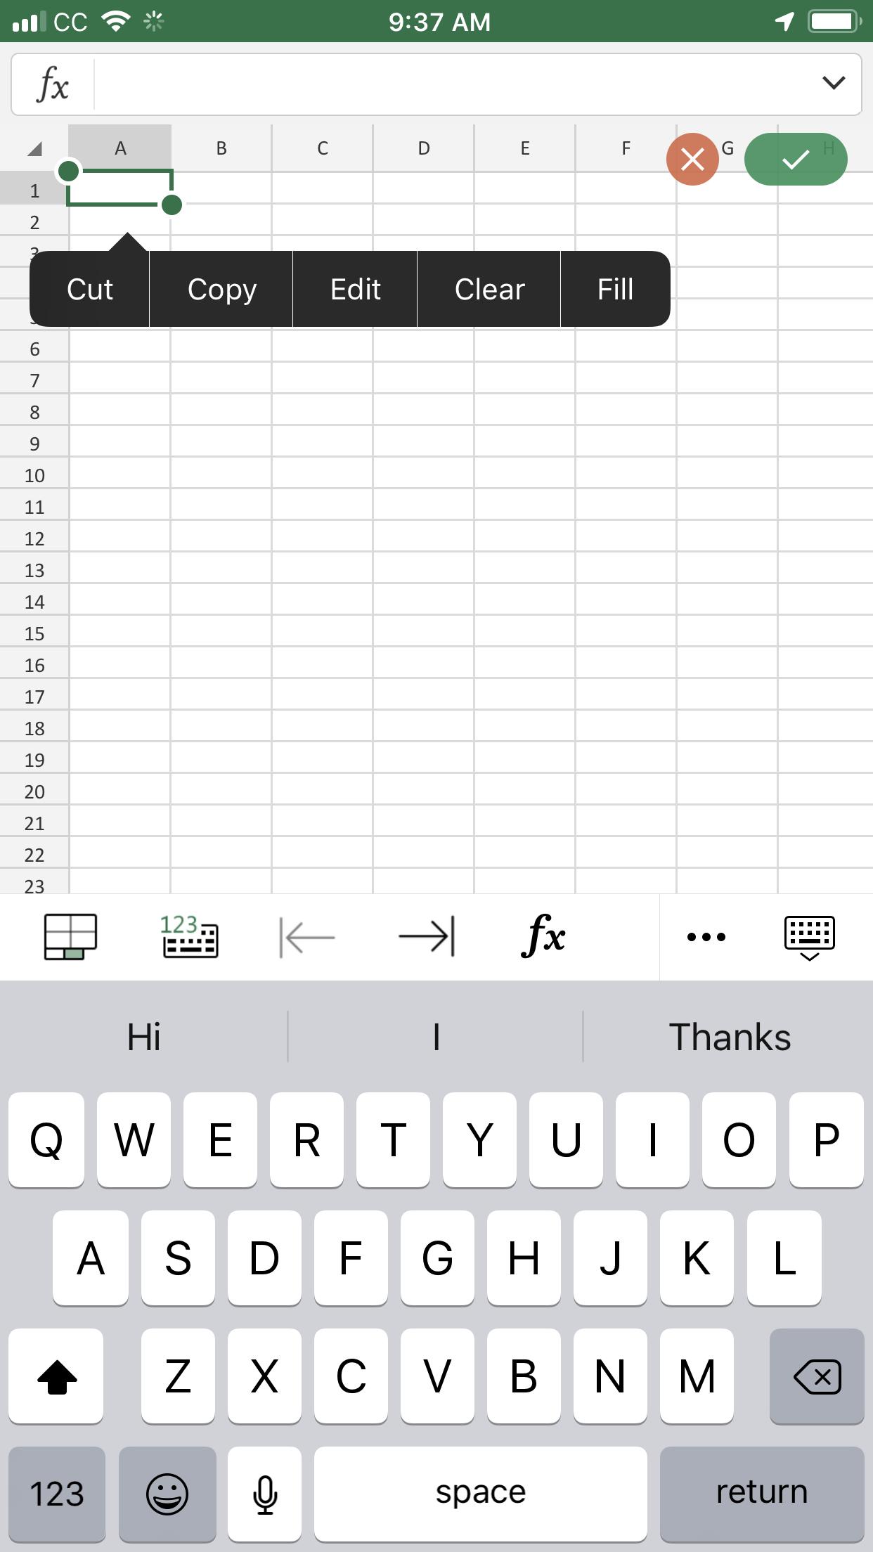
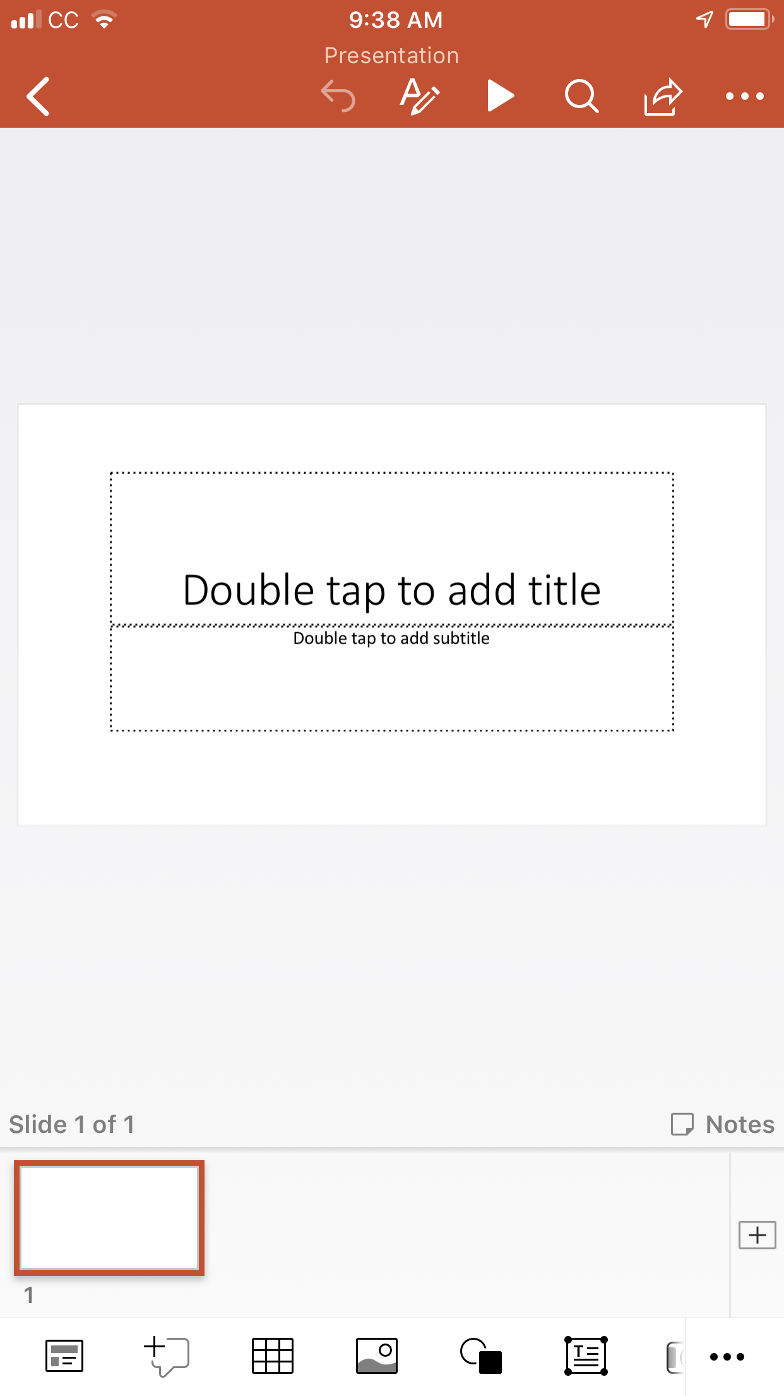
Download and work in the mobile apps
Word, Excel,
PowerPoint,
OneNote, Outlook
1
Download and then launch any Office app like Word, Excel, or PowerPoint.
2
Sign in with your Office 365 account.
3
Create and edit documents in these apps right from your phone: open files, edit text, adjust formatting, and even add pictures.
CC
9:23 AM
CC
9:23 AM
CC
9:23 AM
Document
Presentation
Cut
Copy
Edit
Clear
Fill
Double tap to add title
Double tap to add subtitle
123
Hi
I
Thanks
Hi
I
Thanks
Q
W
E
R
T
Y
U
I
O
P
Q
W
E
R
T
Y
U
I
O
P
A
S
D
F
G
H
J
K
L
A
S
D
F
G
H
J
K
L
Slide 1 of 1
Notes
Z
X
C
V
B
N
M
Z
X
C
V
B
N
M
123
space
return
123
space
return
1

Slide 3
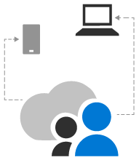

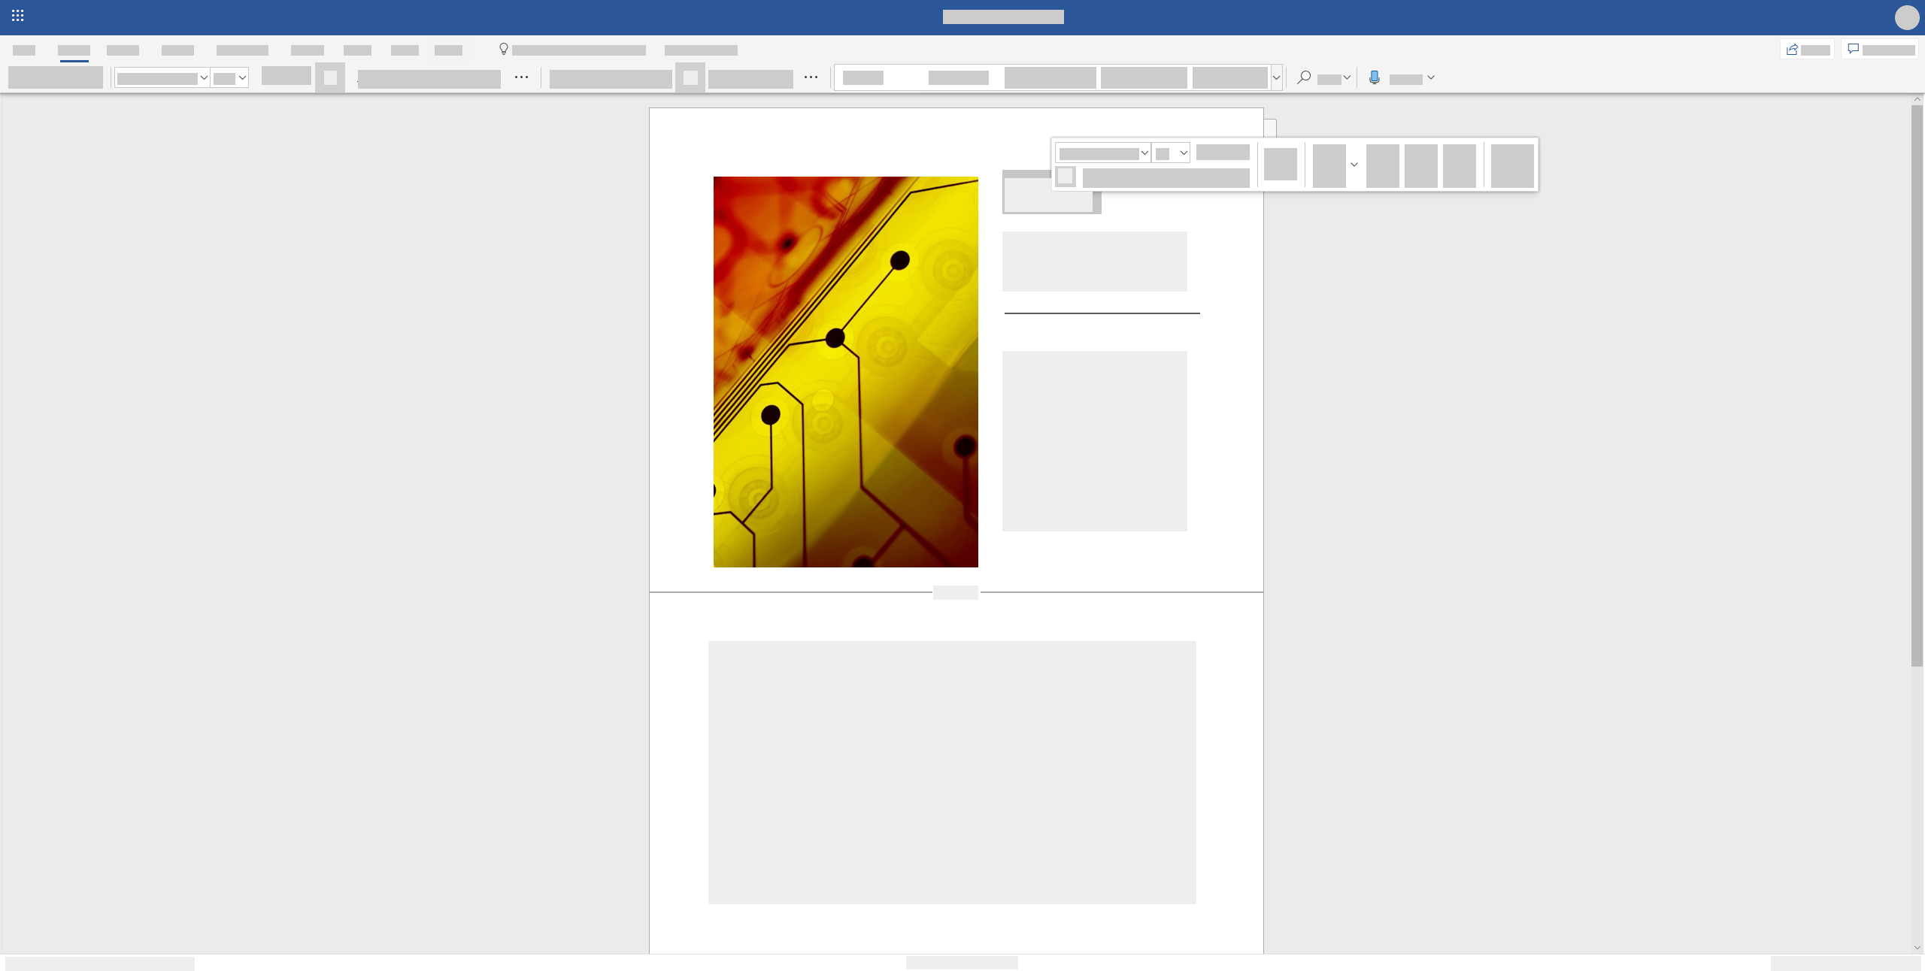
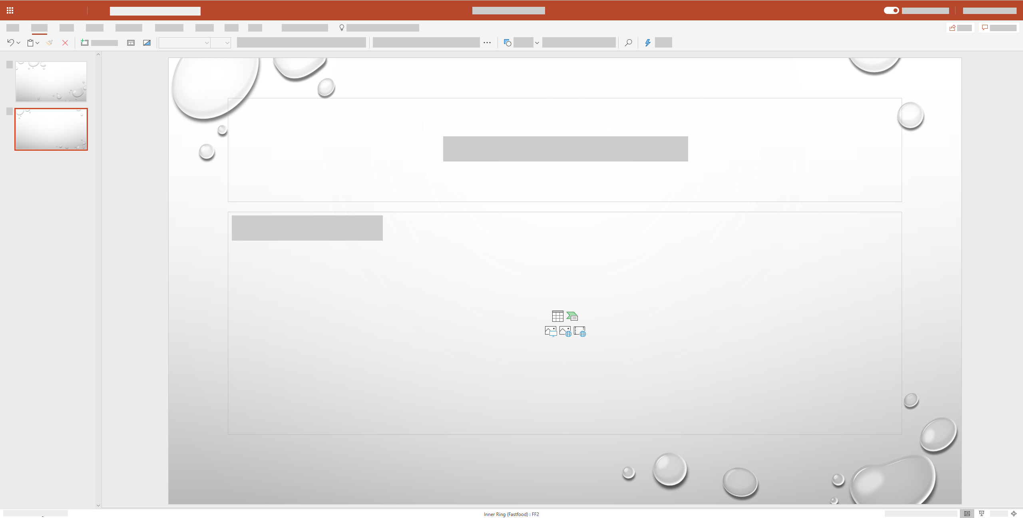
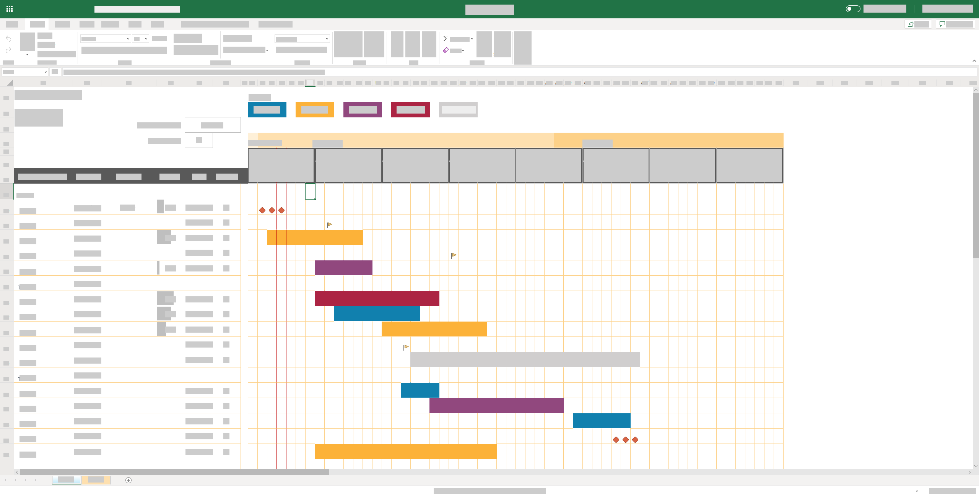
Work in Office Online in your browser
Word, Excel,
PowerPoint,
OneNote, Outlook
1
Sign in to Office.com with your Office 365 account and then launch any Office app.
2
Create and edit documents right from your browser.
Open files, edit text, adjust formatting, add pictures, create graphs.
Co-author in Word, Excel, and PowerPoint.
Word Online
PowerPoint Online
Excel Online

Slide 4
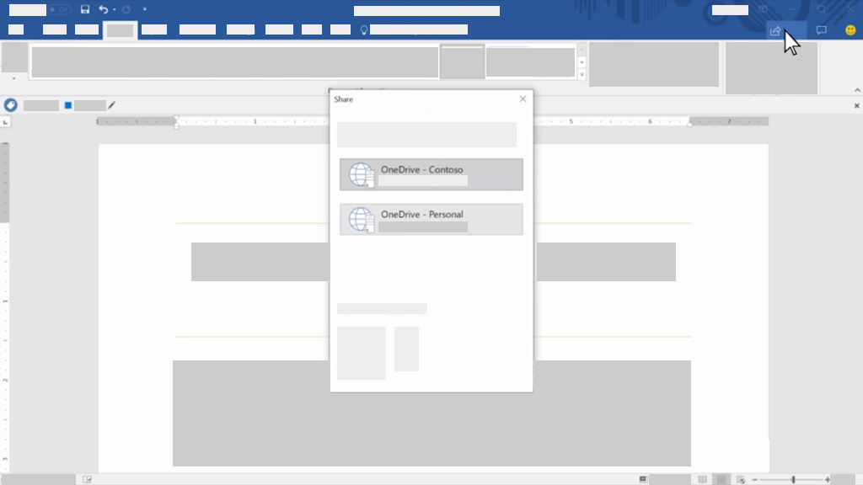
Share files with coworkers
Send a link to invite someone to work with you
1
With a file open, select Share.
Select the down arrow to choose permissions for the link you will be sharing. Options include:
Anyone (if your organization allows it)
People in your organization
Specific people
Select Apply to save the permissions.
Enter the name or email address of people you want to share with, type a message, and choose Send.
Or select Copy Link and send the link in an email or message.
Share
2
Share
OneDrive - Contoso
OneDrive - Personal
3
4
For more information, visit aka.ms/modernworkplacetraining

